Slide 1
Engineering Exploration – Introduction to Internet of Things (23EE001)
Presentation
on
Project / Problem Statement
Name of Student1 Id : 2211981282
Name of Student2 Id : 2211981284
Name of Student3 Id : 2211981308
Name of Student4 Id : 2211981315
Name of Student5 Id : 2211981316
Under the supervision
of
Dr. Monika Parmar
Chitkara University School of Engineering and Technology,
Chitkara University, Himachal Pradesh

Slide 2
NAME OF IDEA : SMART PLANT WATERING SYSTEM
A Smart Plant Watering System is an innovative solution that utilizes technology to automate and optimize the process of watering plants. This system integrates various sensors, actuators, and communication devices to monitor and control the watering of plants in a more efficient and precise manner.

Slide 3
Technology Stack for Smart Plant Watering System :
Microcontroller/Processor:
Core processing unit (e.g., Arduino, Raspberry Pi).
Sensors:
Soil Moisture, Temperature, Humidity sensors.
Actuators:
Water Pumps, Valves for precise water control.
Communication:
Wi-Fi, Bluetooth, or IoT connectivity.

Slide 4
5.Software:
1.Embedded Software/Firmware for processing.
2.Communication Protocol (MQTT, HTTP).
3.User Interface: Web/Mobile App
Power Supply:
1.Battery or Solar for sustainability.
Security:
1.Encryption protocols for data protection.
2.Access control for user authentication.

Slide 5
8.Visuals:
1.Icons representing components.
2.Simple flowchart showing data flow.

Slide 6
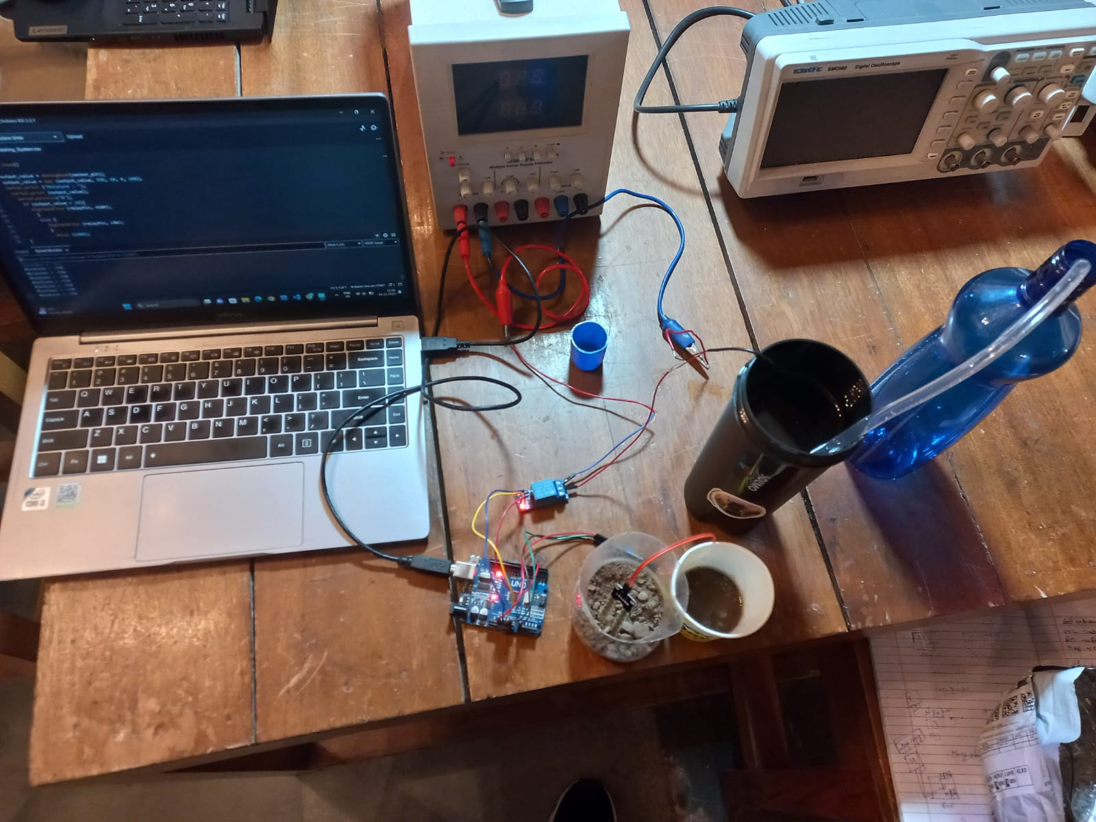
Add process flow chart or simulated image of prototype or any relevant image related to your idea :

Slide 7
Applications of Smart Plant Watering System
Residential Gardens:
Automated watering for home gardens.
Convenient for individuals with busy schedules.
Agriculture:
Precision irrigation in farming.
Optimal water use for crop cultivation.
Public Spaces:
Smart watering for parks and urban landscapes.
Enhances green spaces sustainably.

Slide 8
4.Greenhouses:
Controlled watering for greenhouse cultivation.
Improved yield and resource efficiency.
5.Environmental Conservation:
Promotes water conservation.
Sustainable plant care for eco-friendly initiatives.

Slide 9
Questions???
ANY QUSTIONS??

Slide 10
THANK YOU

